Slide 1
Angular2

Slide 2

Course Objective
To understand and develop rich interactive Web Application using Angular2.

Slide 3
Session Plan
Introduction to Angular2
Typescript
Angular2 Architecture
Module
Component
Template
Metadata
Data Binding
Directives
Services
Dependency Injection
Routers
Forms
Using a Service

Slide 4
References
To learn more about angular2:
- http://www.angular2.com/
- https://angular.io/docs
- http://learnangular2.com/
For more information about architecture:
- https://angular.io/guide/architecture
For Typescript
- https://www.learnhowtoprogram.com/javascript/angular-js/typescript-
introduction-and-installation

Slide 5
Introduction to Angular2
Angular2 is the most advanced framework for the web.
It empowers developers to build applications that live on the web, mobile, or the desktop.
It aims to simplify both the development and testing of such applications by providing a framework for client-side model–view–controller (MVC) and model–view–view-model (MVVM) architectures, along with components commonly used in rich internet applications.
Angular2 has rebuilt the entire framework in TypeScript,
Angular2 combines declarative templates, dependency injection, end to end tooling, and integrated.

Slide 6
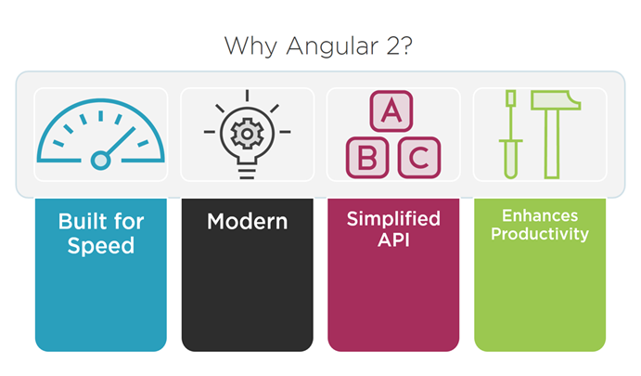
Why Angular2?
It makes mobile apps easier to handle things and improves performance, load time, etc.
Angular2 is component driven. The complexity of the core AngularJS will be removed, resulting better performance.
Angular2 targets ES6 and make harder for any hacks or workarounds which ensures the security of the particular business domain.

Slide 7
Angular2 Features
Browser Compatibilty:
- It supports IE 9, 10, 11, Firefox, Chrome, Safari, Android 4.1 & Microsoft Edge.
Cross platform:
- It can run on desktop, mobile, Android, iOS, etc.
Development
It provide full support for CS5, TypeScript, Dart, ES6, other languages that compile to JavaScript.
Mobile Support
Angular 2.0 is mobile oriented architecture. There are libraries i.e. Native script which helps mobile development fast.
TypeScript
TypeScript(TS) is used heavily in Angular 2. Google currently using DART for coding. DART or TypeScript can be used for Angular 2
No $Scope in Angular2 Angular 2 is not using $scope anymore to glue view and controller

Slide 8
Typescript
Typescript is basically a compiled type language with a strongly typed layer in conjunction with JavaScript.
Typescript allows to write a class, interface, and module statements just like in Java or C# which boosts the performance of the web and mobile solution as the code written in Typescript are less inclined to run-time errors.
For more about Typescript
- https://www.learnhowtoprogram.com/javascript/angular-js/typescript-
introduction-and-installation
TypeScript code:
var message:string =“Hello World”
Console.log(“message”)
Typescript saved with the extension .ts
Compiled JavaScript Code:
var message =“Hello World”
Console.log(“message”)
The file is compiled to Test.js

Slide 9
Angular2 Architecture
The major 8 blocks of Angular2 architecture:
Module
Component
Template
Metadata
Data Binding
Directive
Services
Dependency Injection

Slide 10
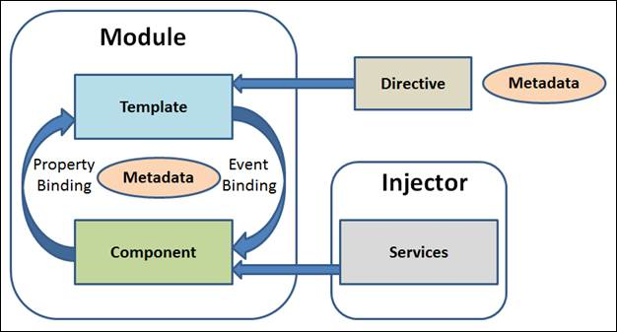
Angular2 Architecture

Slide 11
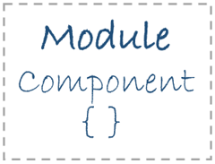
Module
Module is very similar to a class.
A module can be described by a block of code which is used to perform a particular single task.
Angular2 has a feature of modularity, where a single application is built by separating it in many modules.
Export statement is used to export component class from a module.
export class AppComponent
{
….
}

Slide 12
Module (cont..)
App
Modules
Module
code
export
Module
code
import
Module
code
Module
code

Slide 13
Module (cont.)
NgModule decorator to defines the modules.
import {NgModule} from ‘@angular/core’;
@NgModule({
imports: [ …],
declarations: [ … ],
bootstrap: [ … ]
})
export class AppModule{}
Decorator

Slide 14
NgModule
declarations | - the view classes that belong to this module. Angular has three kinds of view classes: components, directives, pipes.
exports | the subset of declarations that should be visible and usable in the component templates of other modules.
imports | other modules whose exported classes are needed by component templates declared in this module.
providers | - creators of services that this module contributes to the global collection of services; - they become accessible in all parts of the app.
Bootstrap | the main application view, called the root component, that hosts all other app views. - Only the root module should set this bootstrap property.

Slide 15
Module (cont.)
Sample app.module.ts file
import { NgModule } from '@angular/core';
import { BrowserModule } from '@angular/platform-browser';
import { AppComponent } from './app.component';
import { SampleComponent } from "./sample.component";
@NgModule({
imports: [ BrowserModule ],
declarations: [ AppComponent,SampleComponent ],
bootstrap: [ AppComponent ]
})
export class AppModule { }

Slide 16
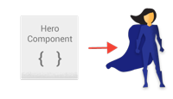
Component
Components are the most basic building block of an UI in an Angular application.
@Component is used to register a component and only one component is used per DOM element.
Component decorator allows you to mark a class as an Angular component and provide additional metadata that determines how the component should be processed, instantiated and used at runtime.

Slide 17
Component (cont..)
App
Component
Module
COMPONENT
export
Module
COMPONENT
import
Module
METADATA
+
CLASS
Module
METADATA
+
CLASS

Slide 18
Component (cont.)
The component would look like.
import {Component} from ‘@angular/core’;
@Component({
selector: ‘ ’,
template: ‘ ’,
})
export class AppComponent{}
Decorator

Slide 19
Component (Cont..)
Sample app.component.ts file
import { Component } from '@angular/core';
@Component({
selector: 'my-app',
template: `<h1>Hello {{name}}</h1>
<sample-app></sample-app> `,
})
export class AppComponent { name = 'Jamuna'; }

Slide 20
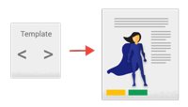
Template
Template is the main part which justifies the look of the component.
It can be said that the view of the component is defined using template.
To display value, add template expression in code
<div>
Your name is : {{name}}
</div>

Slide 21
Template (Cont..)
Template example
import { Component } from '@angular/core';
@Component({
selector: 'my-app',
template: `<h1>Hello {{name}}</h1>`,
})
export class AppComponent { name = 'Jamuna'; }

Slide 22

Directive
Directives are custom HTML attributes used to prolong power of HTML.
To create a directive, @Directive decorator is applied on connected metadata of the class.
Directive decorator allows you to mark a class as an Angular directive and provide additional metadata that determines how the directive should be processed, instantiated and used at runtime.
For More Information about directive
https://angular.io/api/core/Directive
import {Directive} from '@angular/core';
@Directive({
selector: 'my-directive',
})
export class MyDirective {
}

Slide 23

Metadata
Metadata is majorly used to extend the functionality of the class.
Metadata can be attached to TypeScript using a decorator.
For example, to define any component in Angular application,
use metadata of the class (i.e. @Component decorator)

Slide 24

Metadata (cont..)
- The metadata in the @Component tells Angular where
to get the major building blocks you specify for the
component.
- The template, metadata and the component together
describes a view.
- @Injectable, @Input and @Output are a few of the
more popular decorators.

Slide 25
Data Binding
The most powerful feature, Data Binding, is the connection bridge between Model and View.
It gets automatically synchronized.
Angular 2.0 supports four types of binding –
Property Binding
Event Binding
Interpolation
Two-Way Binding

Slide 26
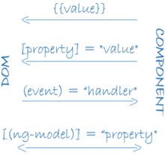
Data Binding (Cont..)
It displays the hero.name property value within the <li>element.
The [hero] property binding the value of selectedHero from the parent HeroListComponent to the hero property of the child HeroDetailComponent.
Interpolation
The HeroListComponent example:
<li>{{hero.name}}</li>
<hero-detail [hero]="selectedHero"></hero-detail>
<li (click)="selectHero(hero)"></li>
Property Binding
The (click) event binding calls the component's selectHero method when the user clicks a hero's name.
Event Binding

Slide 27
Data Binding (Cont..)
It combines property and event binding in a single notation, using the ngModel directive.
Two-way Binding
The HeroListComponent example:
<input [(ngModel)]="hero.name">
In two-way binding, a data property value flows to the input box from the component as with property binding. The user's changes also flow back to the component, resetting the property to the latest value, as with event binding.

Slide 28
Data Binding (Cont..)
Data Binding Demos

Slide 29
Getting Started
my-app
e2e
app.e2e-spec.ts
app.po.ts
tsconfig.e2e.json
node_modules/...
src/...
.angular-cli.json
.editorconfig
.gitignore
karma.conf.js
package.json
protractor.conf.js
README.md
tsconfig.json
tslint.json
For information about quickstart directives:
https://angular.io/guide/quickstart
To set up development environment:
npm install
To start the application:
npm run serve
npm start
Quick Start Template

Slide 30
Demos

Slide 31
Using Pipes
import {Component} from 'angular2/core' @Component({ selector: 'hero-birthday', template: `<p>The hero's birthday is {{ birthday | date }}</p>` }) export class HeroBirthday { birthday = new Date(1988,3,15); // April 15, 1988 }

Slide 32

Services
Services are used when a single functionality is used commonly in various modules of the application.
Basically, is used to share the data and behavior within the application.
Service has no base class.
Commonly used services are logging service, data service, message service, etc.

Slide 33
Services (Cont..)
Module
COMPONENT
Module
COMPONENT
data
server
Module
COMPONENT

Slide 34

Dependency Injection
To attach the functionality of components at runtime, dependency injection is used.
As objects are passed as dependencies, it makes dependencies configurable - removing its hard-coded dependencies.
With dependency injection, components can be easily maintainable, reusable and testable.

Slide 35
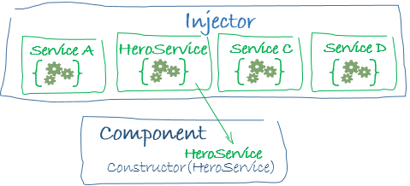
Dependency Injection (Cont..)
constructor(private service:HelloService){}
When Angular creates a component, it first asks an injector for the services that the component requires.
An injector maintains a container of service instances that it has previously created. If a requested service instance is not in the container, the injector makes one and adds it to the container before returning the service to Angular.
When all requested services have been resolved and returned, Angular can call the component's constructor with those services as arguments. This is dependency injection.

Slide 36
Dependency Injection (Cont..)
Points to remember about dependency injection:
Dependency injection is wired into the Angular framework and used everywhere.
The injector is the main mechanism.
An injector maintains a container of service instances that it created.
An injector can create a new service instance from a provider.
A provider is a recipe for creating a service.
Register providers with injectors.

Slide 37
Routers
The Angular Router enables navigation from one view to the next as users perform application tasks
Enter a URL in the address bar and the browser navigates to a corresponding page.
Click links on the page and the browser navigates to a new page.
Click the browser's back and forward buttons and the browser navigates backward and forward through the history of pages you've seen.
import { RouterModule, Routes } from ‘@angular/router’;

